Slide 1
Title: E-Gift Shoppee
Presented By
Aravapalli Sai Ravi Teja

Slide 2
Team 9
Sai Ravi Teja Aravapalli
Sabarigiri Vasan S
Reyaan Riyaz Shaikh
Sana Ravitejeswar Reddy
Sarvakota Pooja Vinaya Manasa
Sandhya Ajay babu

Slide 3
Contents
Objective
DotNet Framework
Actors
Admin Operations
User Operations
Front-End
Back-End(Database)
Conclusion

Slide 4
Objective
The primary goal of e-commerce is to reach maximum customers at the right time to increase sales and profitability of the business. Functions of e-commerce include buying and selling goods, transmitting funds or data over the internet.
The primary objective of an e-commerce website is to sell products or services.
Secondary objectives include: providing customers with product information, reviews and comparison options.

Slide 5
E-Gift Shoppee
E-Gift Shoppe is a very important feature used in e-commerce to assist people making purchase any products online.
This project deals with developing an e-commerce website for different types of gifts. It provides the user with a catalogue of different types of gifts available to purchase in the store.
In order to facilitate online purchase, a shopping cart is provided to the user.
The system is implemented using the Technologies:
HTML, CSS, JS
ASP .NET MVC Pattern
SQL Server Management System

Slide 6
E-Gift Shoppee (contd.)
The admin is the main user who will monitor the activity of each user.
Only the admin can create new records, delete the existing records or update the records.
The customer who is new to the system has to register.
The information is kept private and confidential.
The Information of one user cannot be viewed by other users.
The customer who has already registered can login.
The customer can place order of their choice and can track their order.

Slide 7
DotNet Framework
DotNet is a scalable and robust framework for building web and enterprise applications.
The DotNet framework is a safe type environment for application development and code execution.
Microsoft DotNet applications can be written in languages such as C#, F# or Visual Basic. These applications then run on any compatible Operating System.
The framework supports the development as well as maintenance of modern-days applications and XML web services.

Slide 8
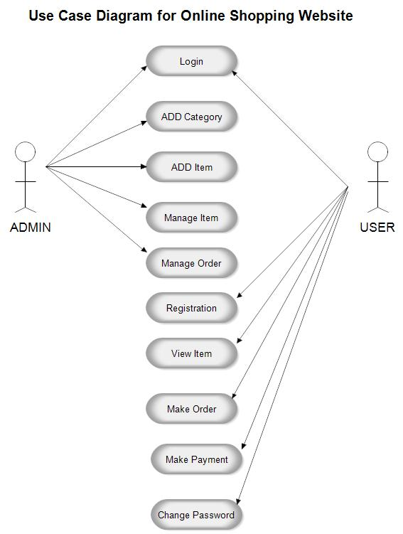
Use Case diagram
Actors
Admin
User

Slide 9
Admin Operations
Login.
CRED operations on Users.
CRED Operations on Categories.
CRED Operations on Products.
Search Products.
Manage Orders.
Update Order Status.
Log Out.

Slide 10
User Operations
New User Registration Form.
User Login.
Explore Products Interface & Categories.
Search Products.
Add To Cart.
Order from Cart.
Cancel Order.
Log Out.
Password Reset.

Slide 11
SQL Tables:
UserMasters.
Products.
Categories.
Cart.
Orders.

Slide 12
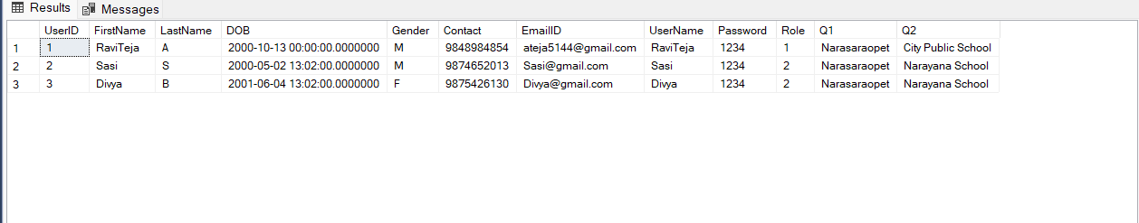
UserMasters Table

Slide 13
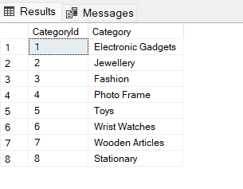
Categories Table

Slide 14
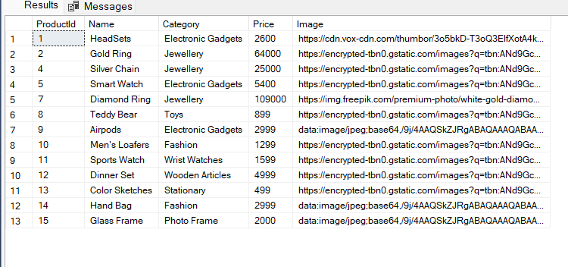
Products

Slide 15
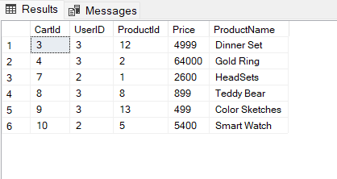
Cart

Slide 16
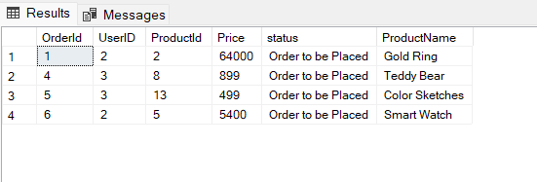
Orders

Slide 17
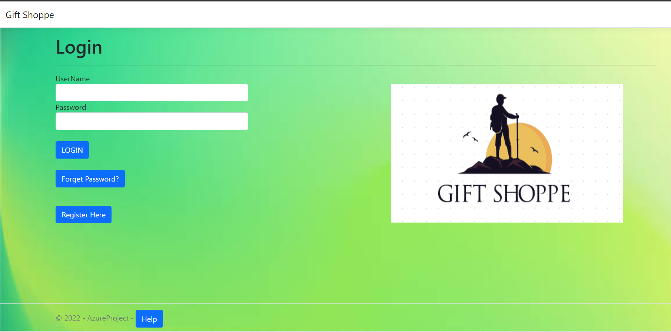
LOGIN SCREEN
The admin can login through login page with their credentials.

Slide 18
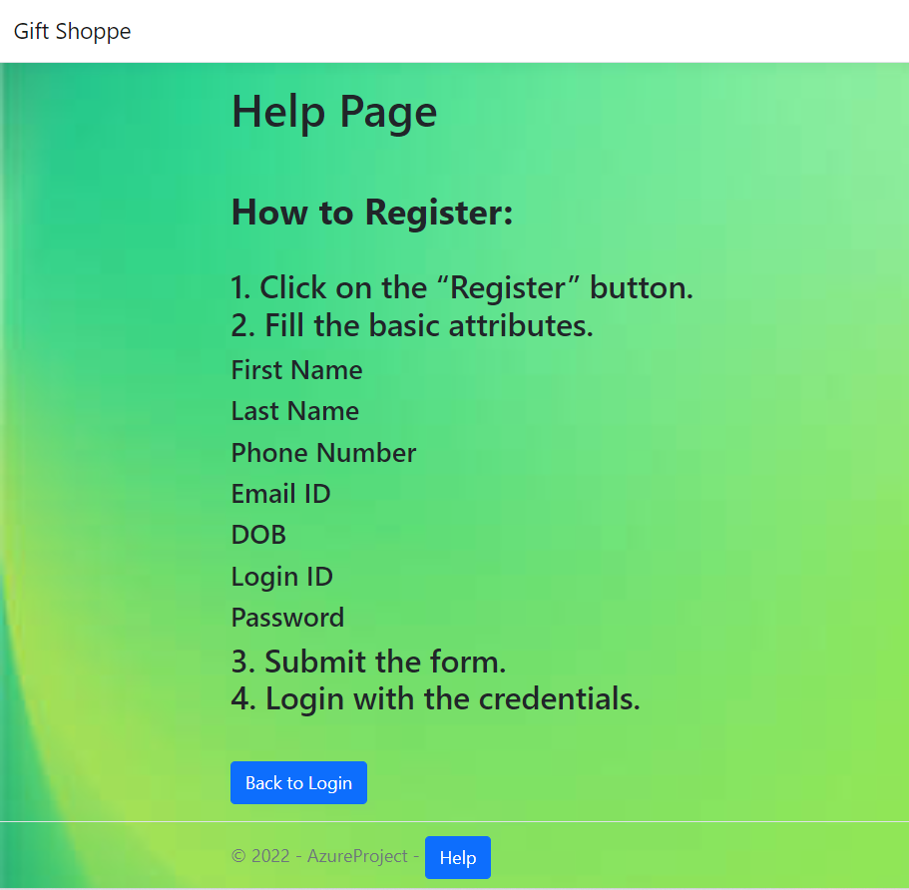
Help View

Slide 19
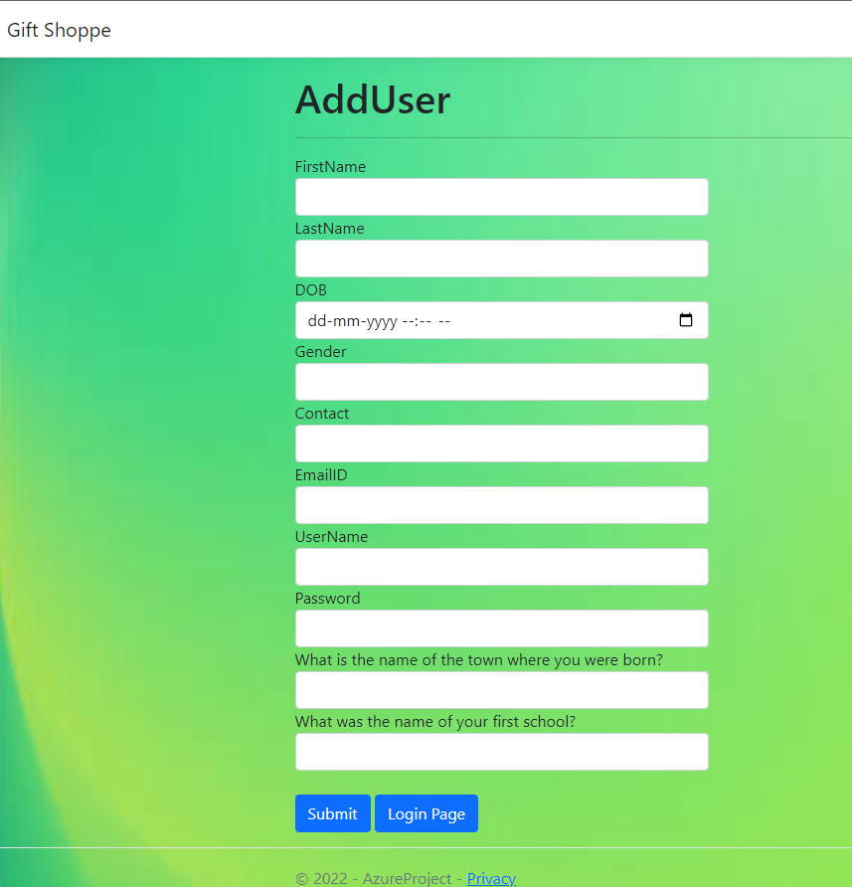
New User Registration Page
New user should register by providing few details. Security questions are required for password recovery.

Slide 20
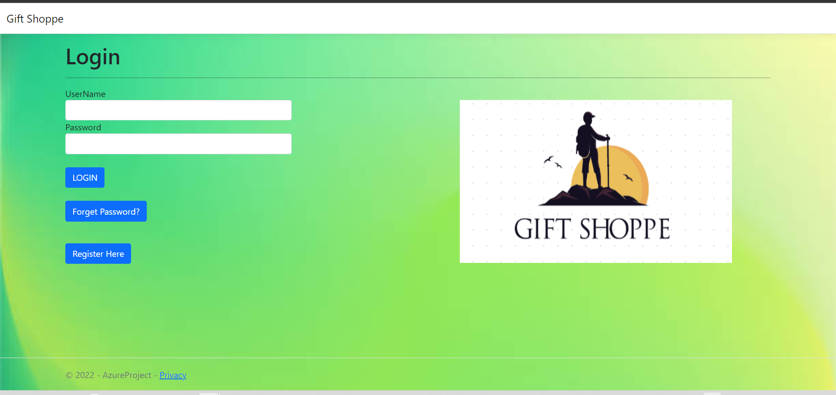
Login Page
The user who have already registered can login directly. Incase if the user forget his/her password, they can click on ‘forget password’ to recover their password.

Slide 21
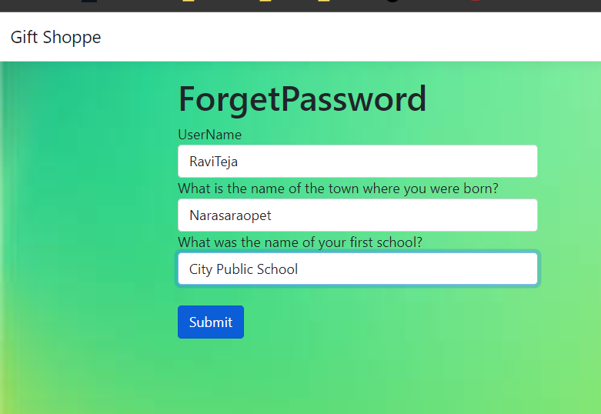
Forget Password View
The security questions are asked for authentication, to validate the user is authorized user or not.

Slide 22
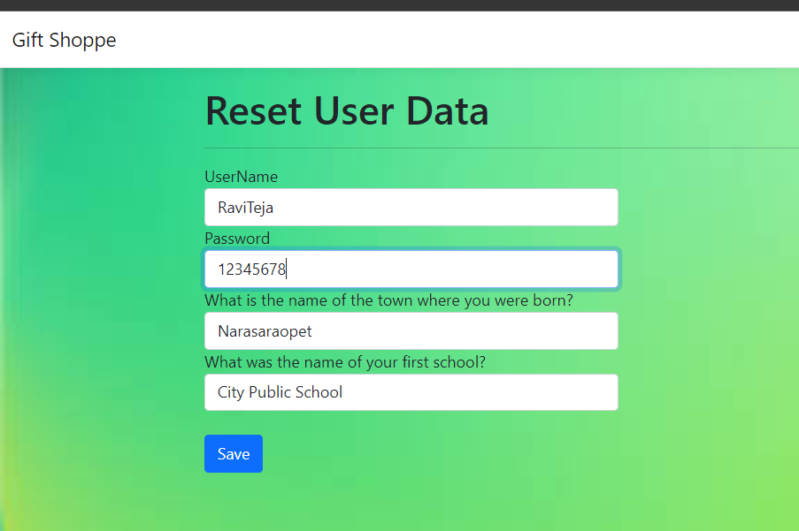
Updating the User Data
If the credentials are validated then the user can reset the password.

Slide 23
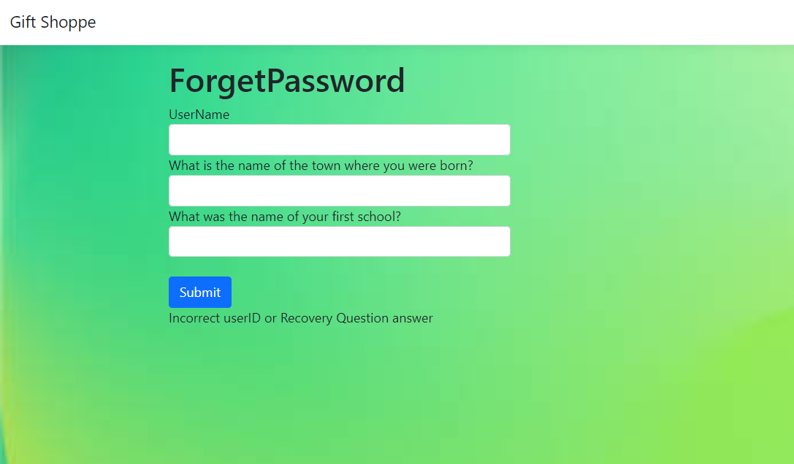
Forget Password (Incorrect credentials)
If the values are not validated then the page is displayed as follows.

Slide 24
Logging in as an Admin

Slide 25
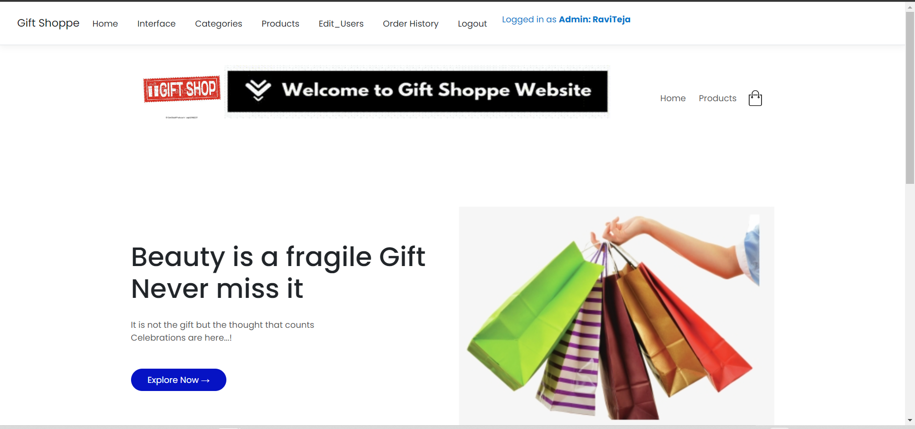
Home Page for Admin
The below page is displayed to the admin after login.

Slide 26
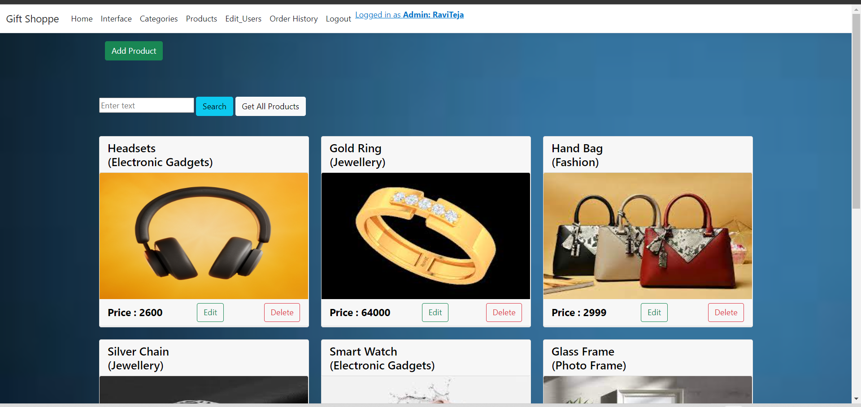
Interface (admin view)
Only the admin can edit the products.

Slide 27
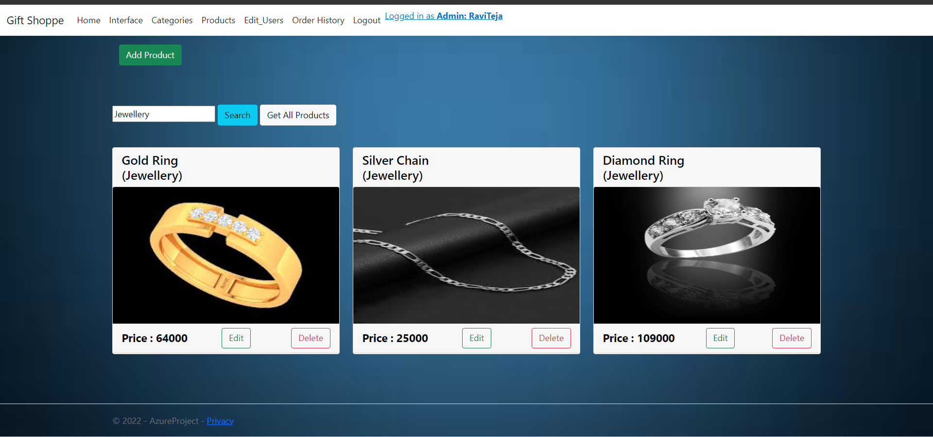
Searching products
Search bar is used to search for a particular item. It displays the specified results.

Slide 28
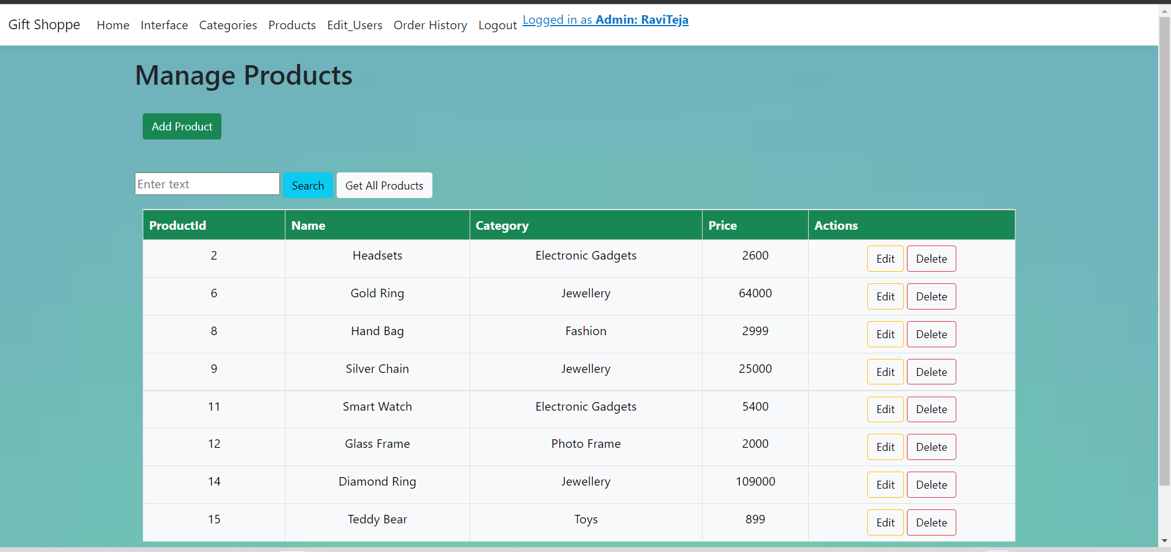
Products List View (as a admin)
The admin can view the list of Products and perform CRED operations as per re

Slide 29
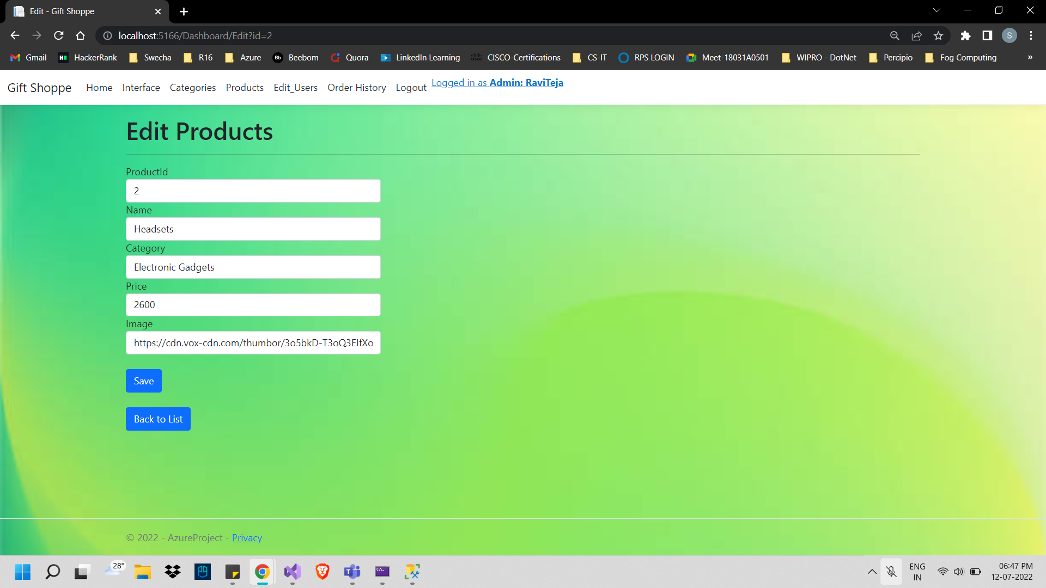
Updating the details of a Product

Slide 30
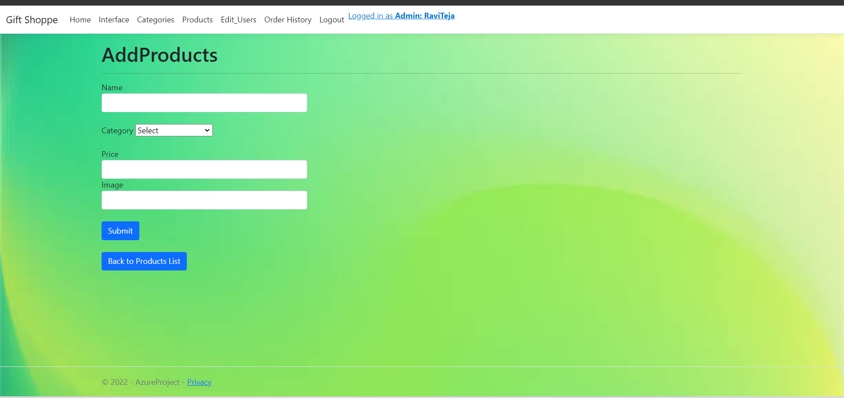
Adding a new Product
Only the admin can add the product. The category of the product should be selected from the drop down.

Slide 31
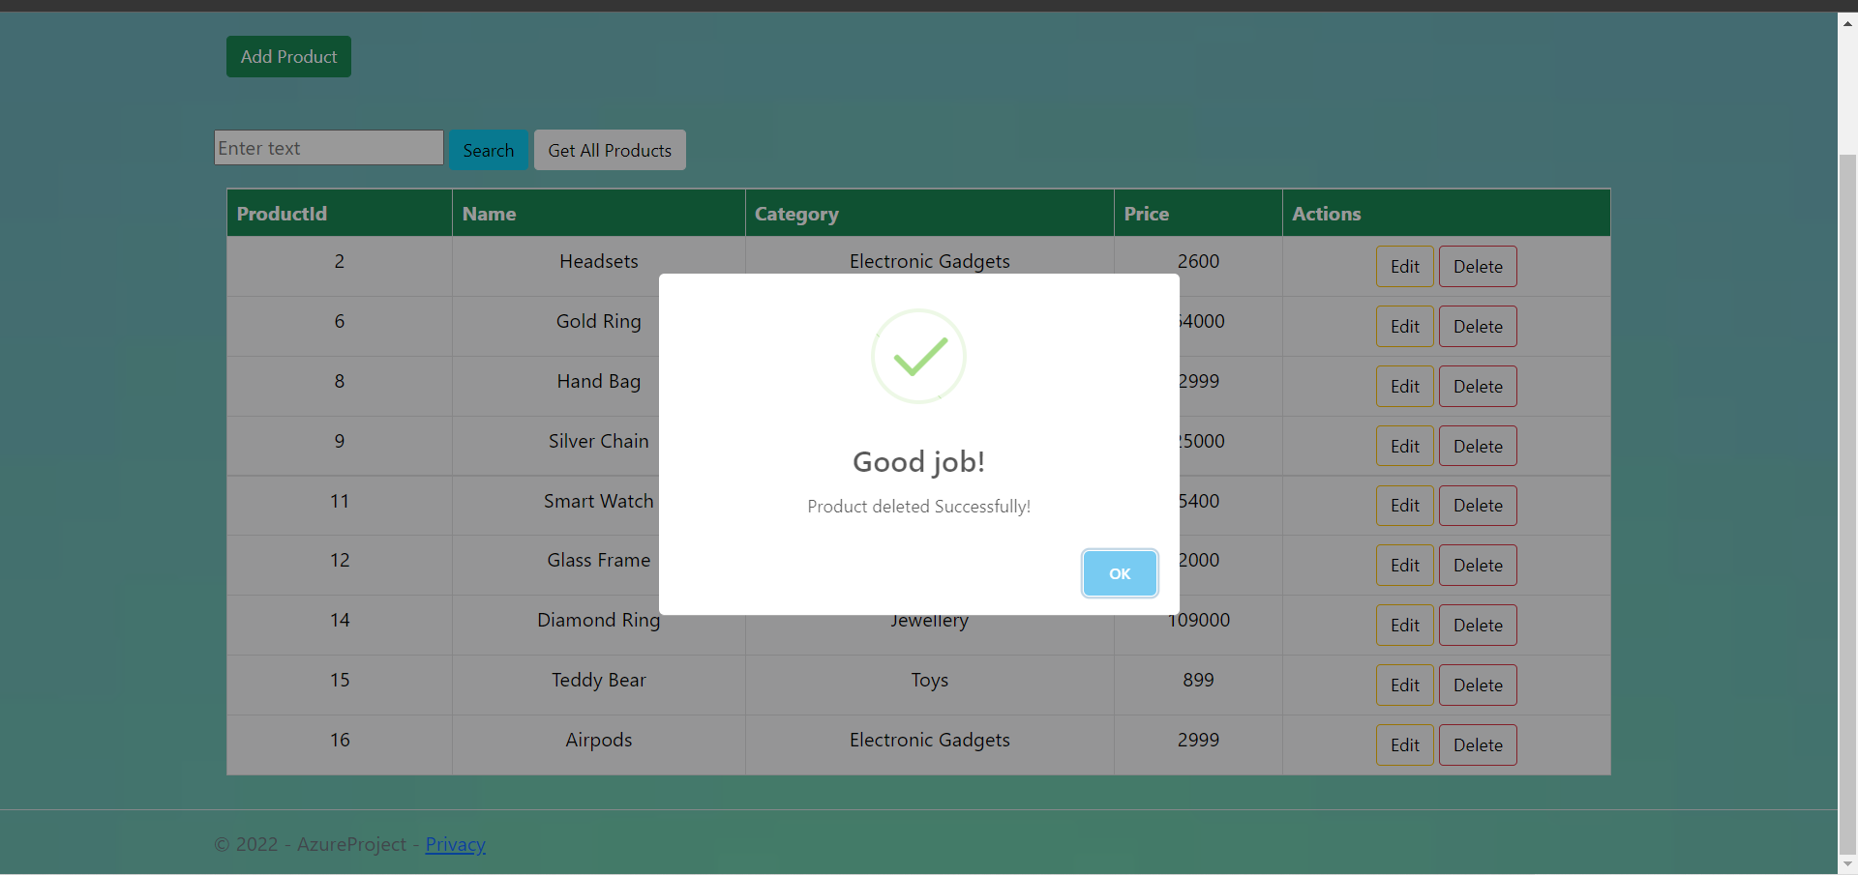
Deleting a Product

Slide 32
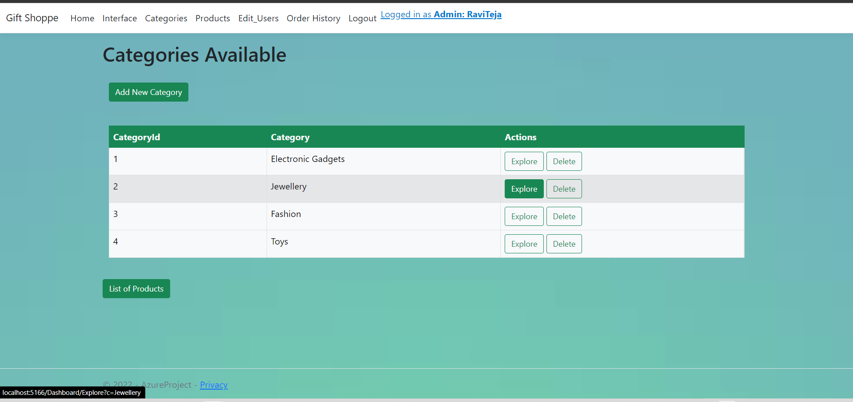
Categories Page
All the available categories are displayed in this page.

Slide 33
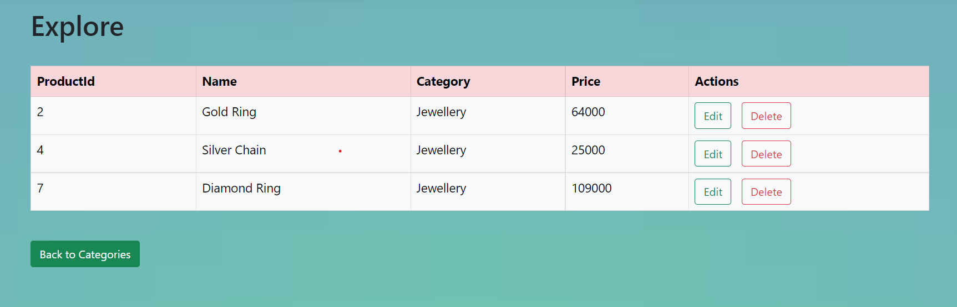
Products View

Slide 34
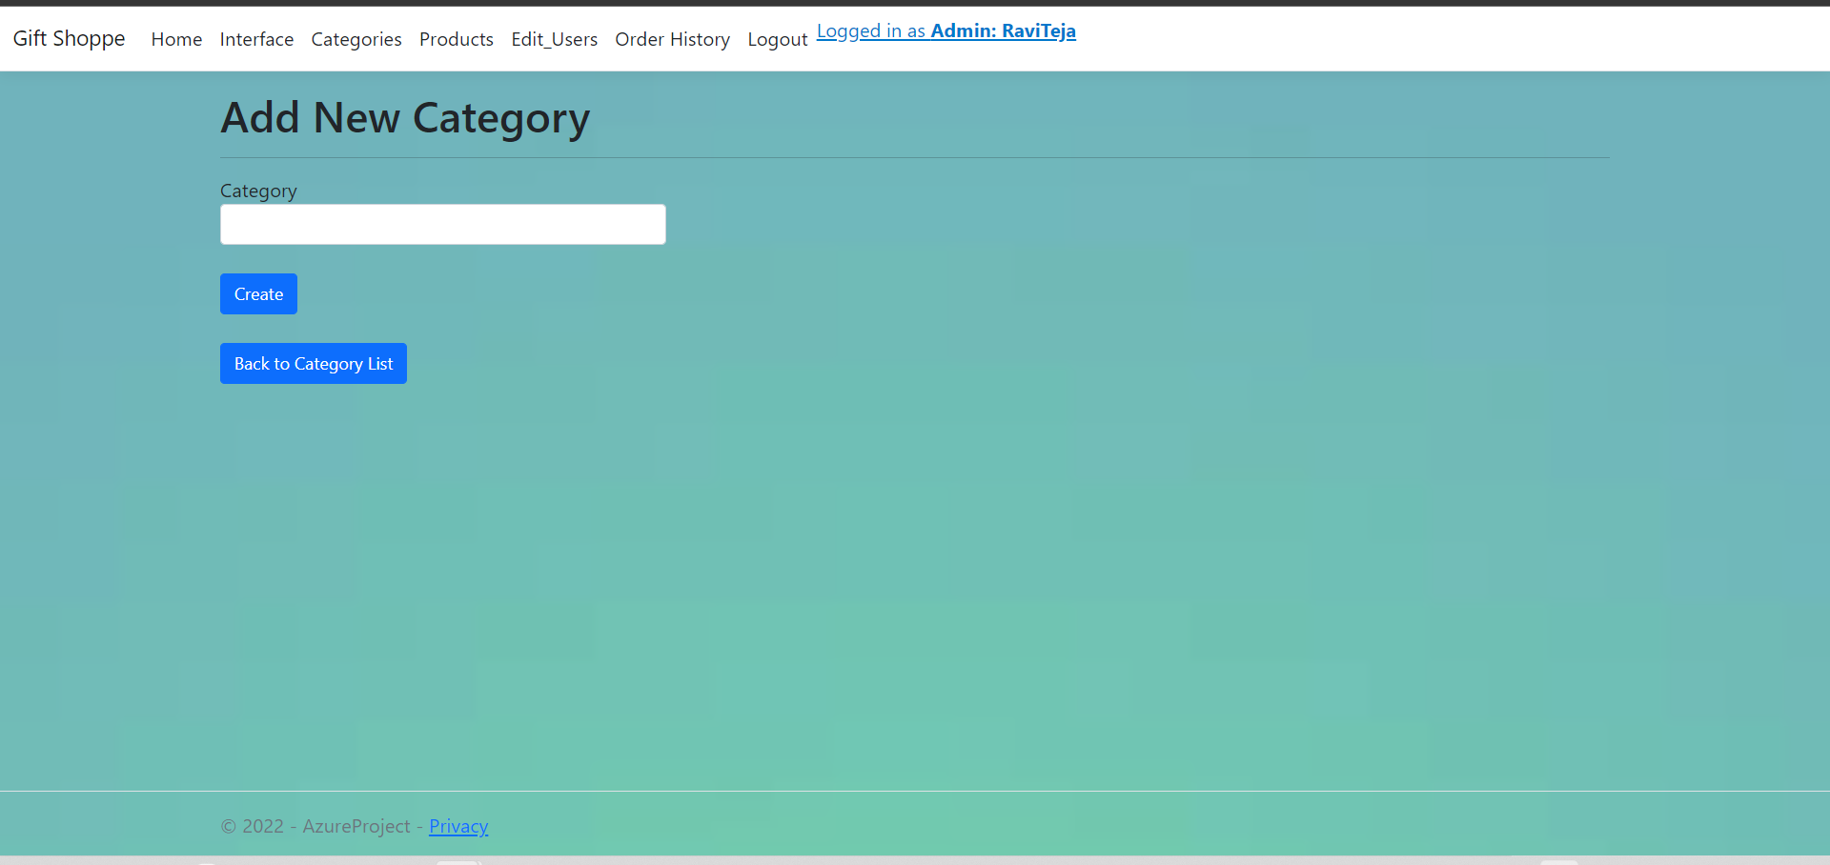
Adding a New Category
A new category can be created in this page.

Slide 35
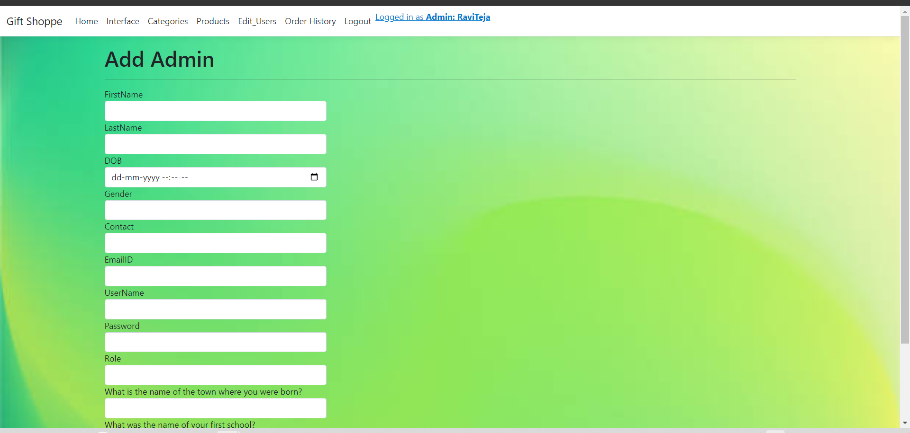
Adding a new Admin
A new admin can be added only by an existing admin through admin page.

Slide 36
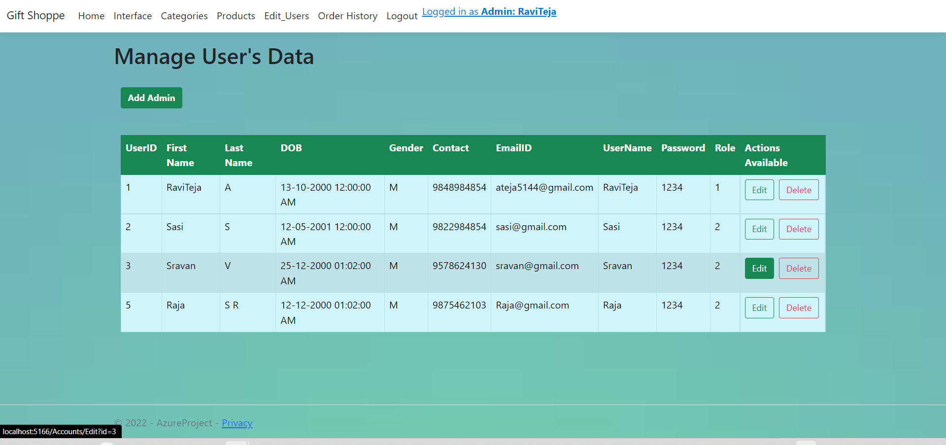
Managing User’s Data
User’s data can be managed by the admin.

Slide 37
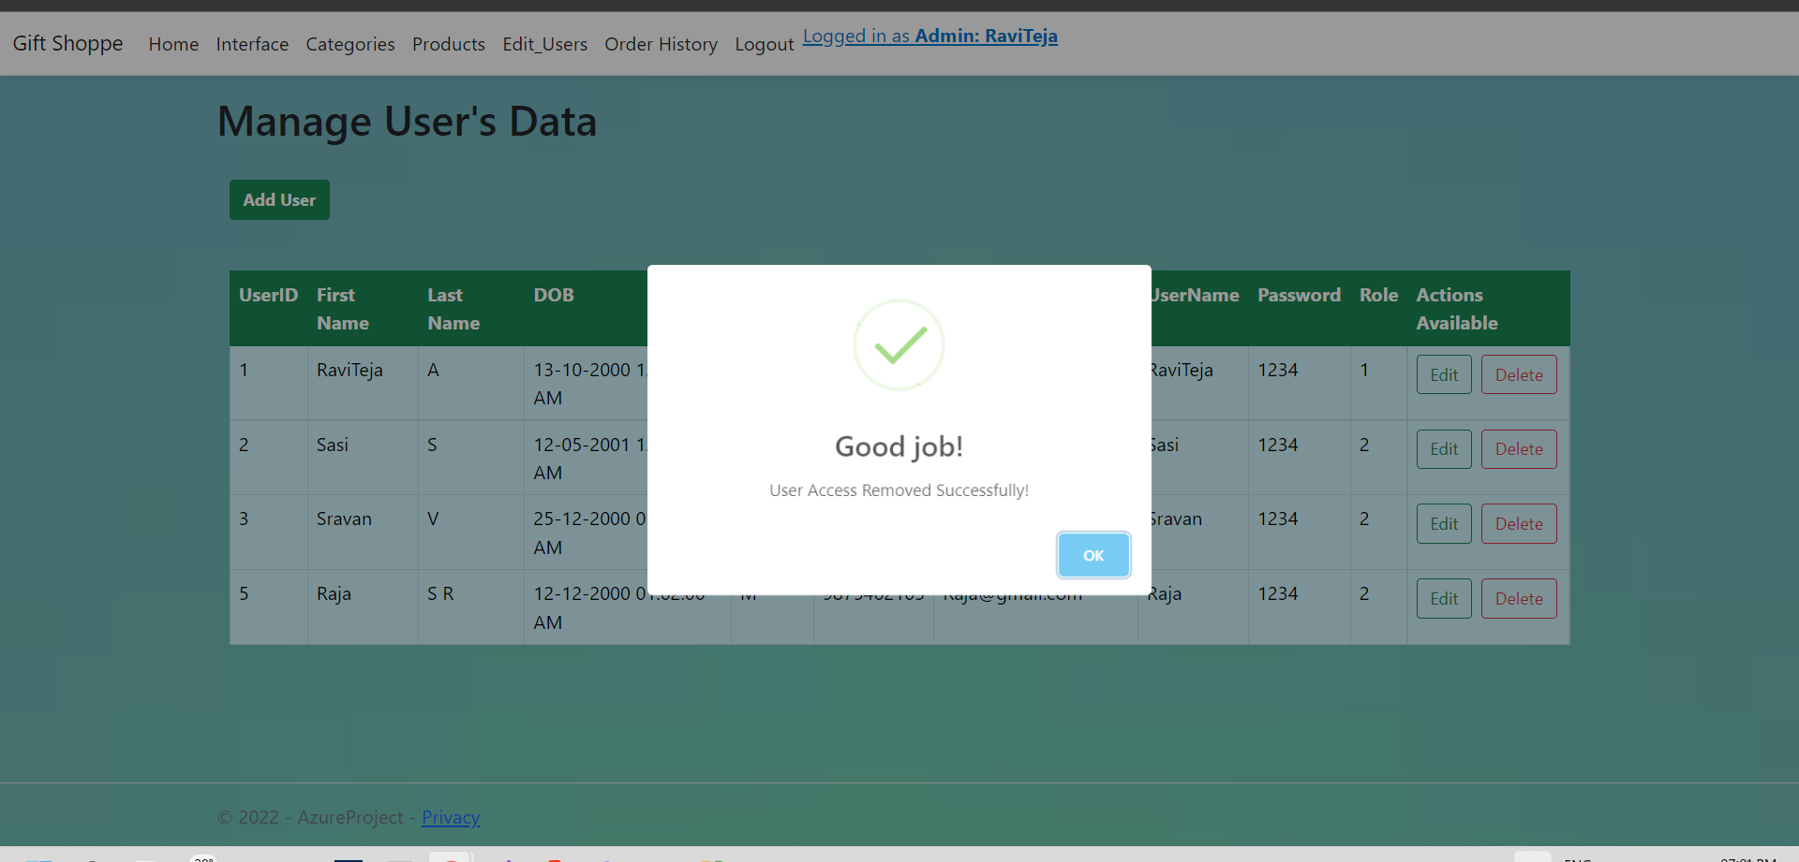
Remove User Access
Admin can remove the user access.

Slide 38
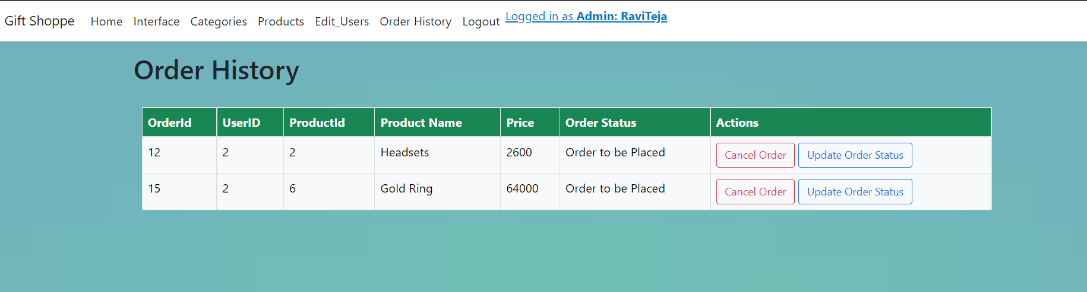
Order History (admin view)
The orders placed by the users are displayed in this page as below. The admin can update the status of the order.

Slide 39
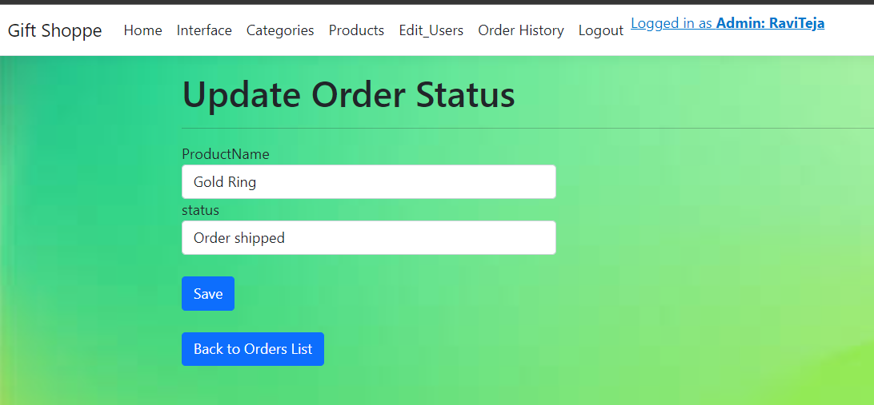
Updating the Order Status
The order status is being updated from ‘order placed’ to ‘order shipped’.

Slide 40
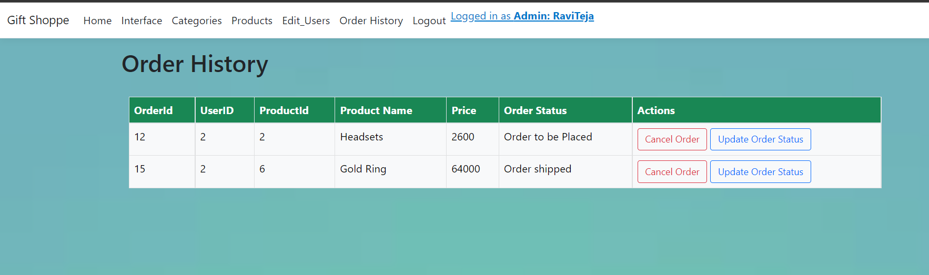
After Updating the Order Status
The order status will be updated in the order history.

Slide 41
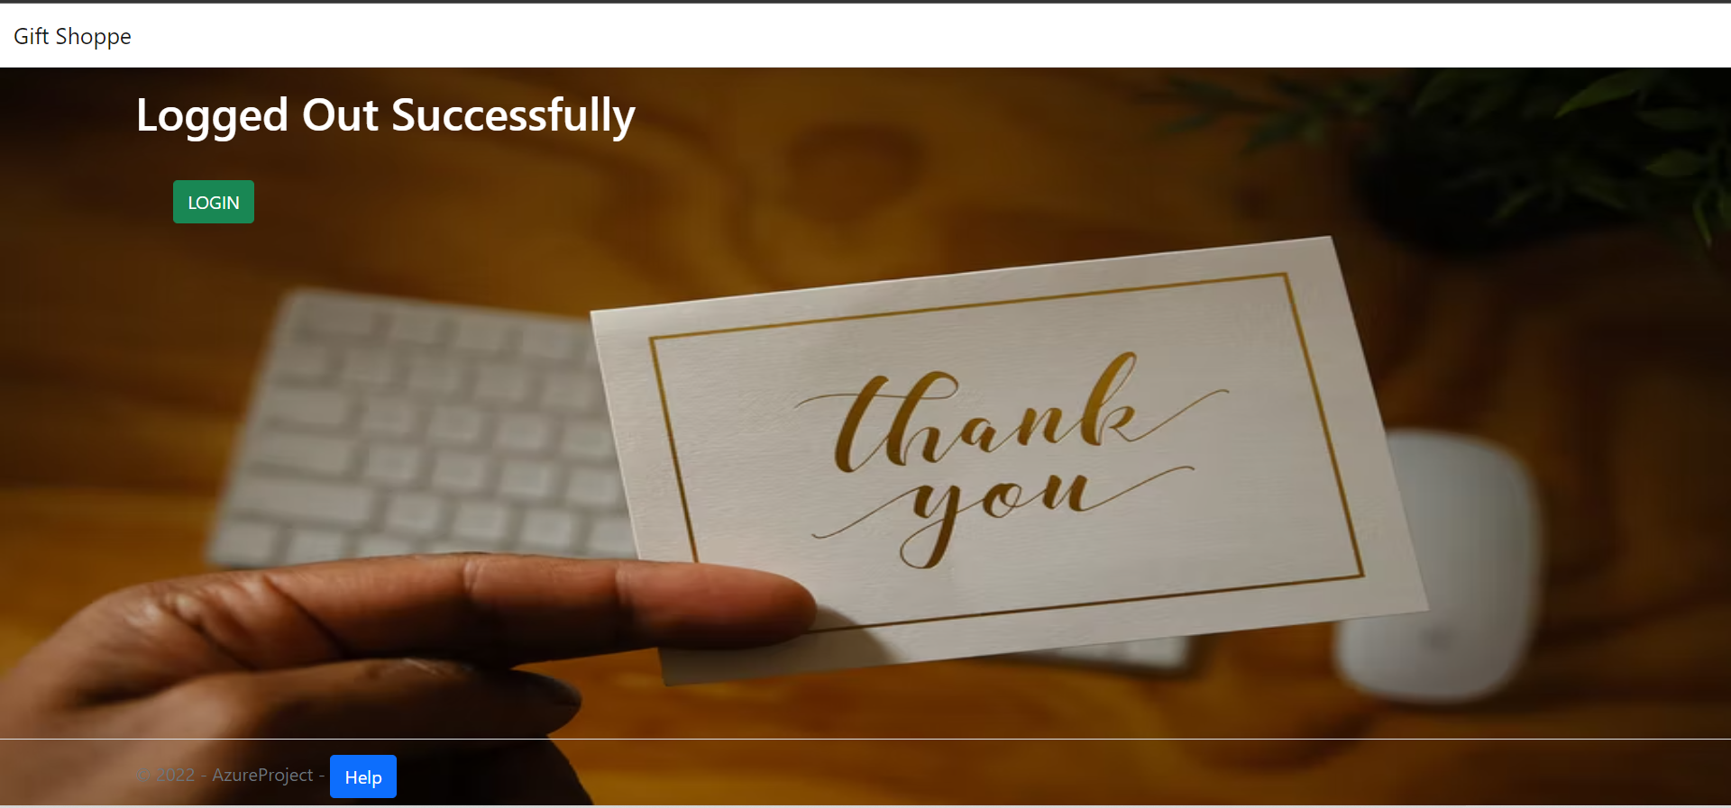
LogOut Page

Slide 42
Logging in as User

Slide 43

Logged in as User
After successful login, the home screen is displayed to the user as follows.

Slide 44
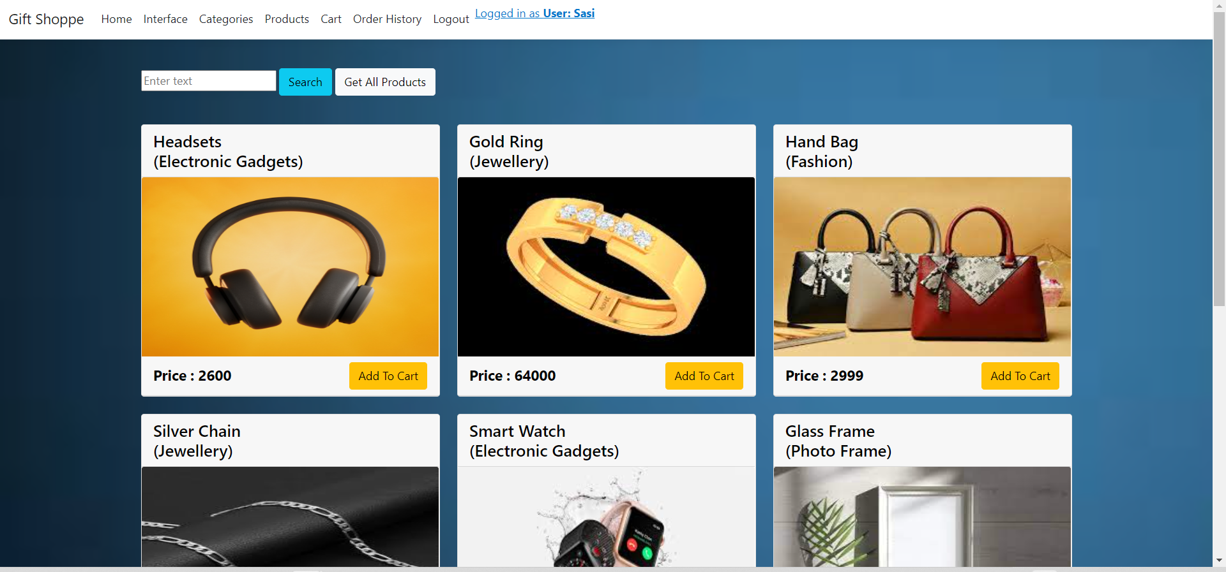
User Interface (User View)
The user cannot edit the products but can perform ‘add to cart’ operation.

Slide 45
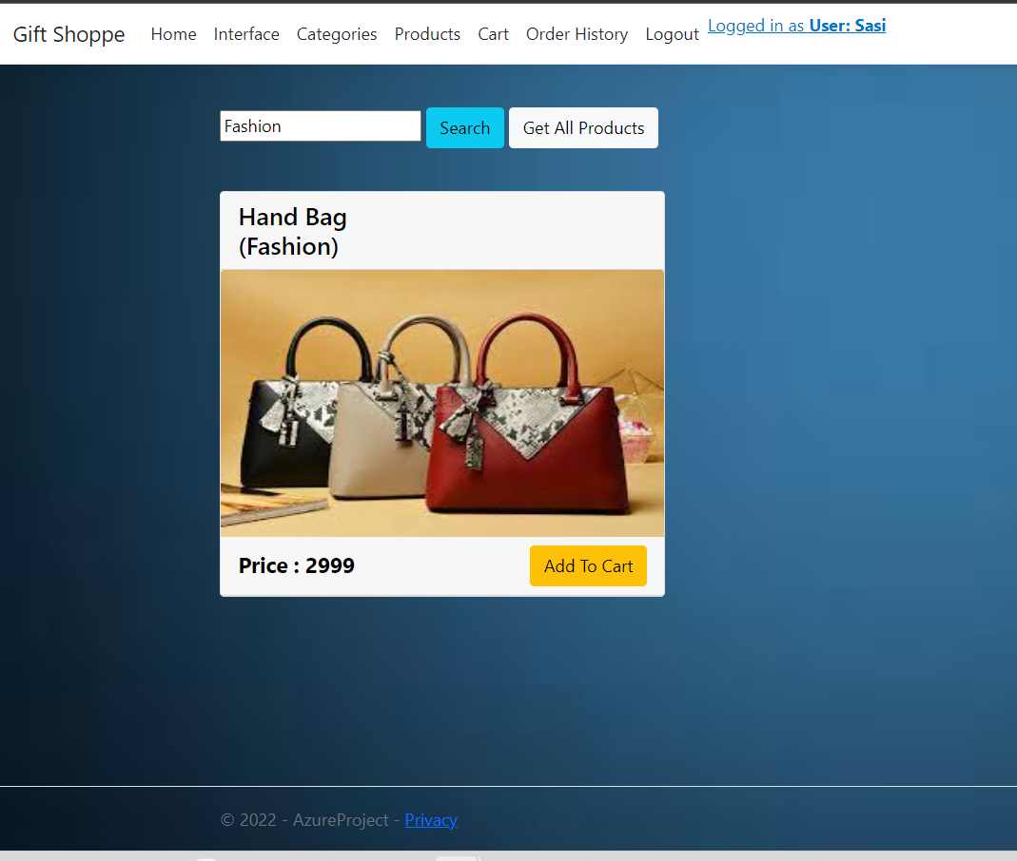
Search Results

Slide 46
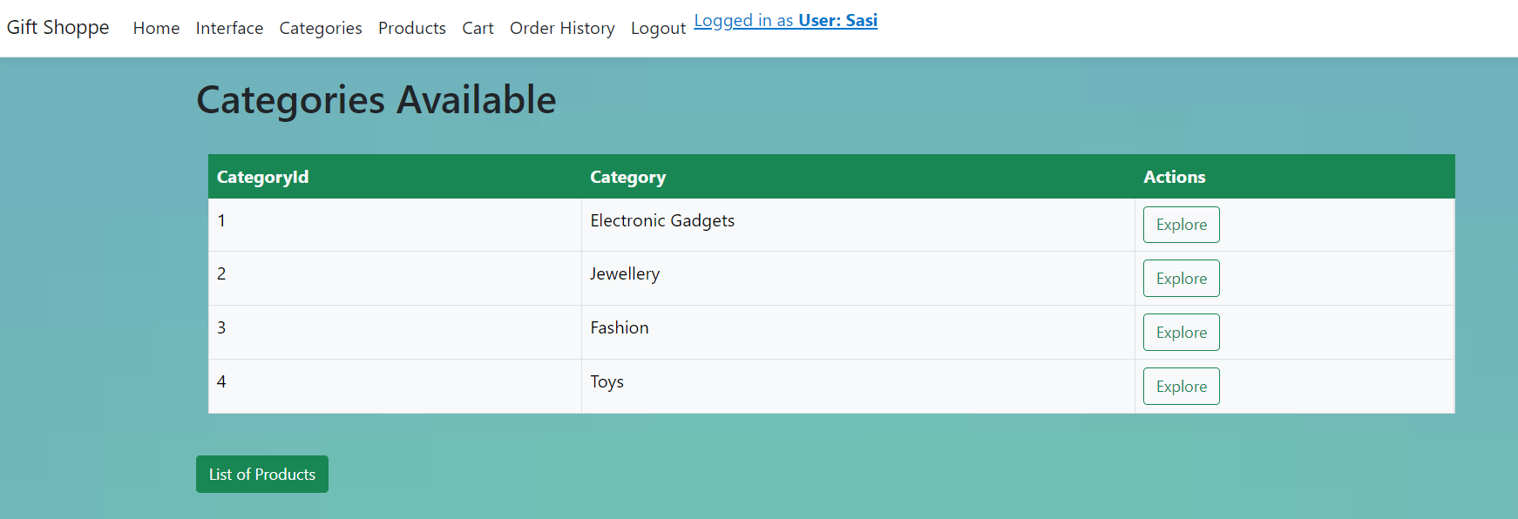
List of Categories

Slide 47
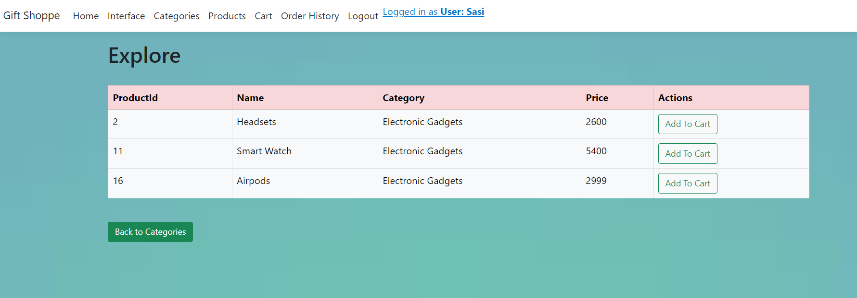
Selecting a Category

Slide 48
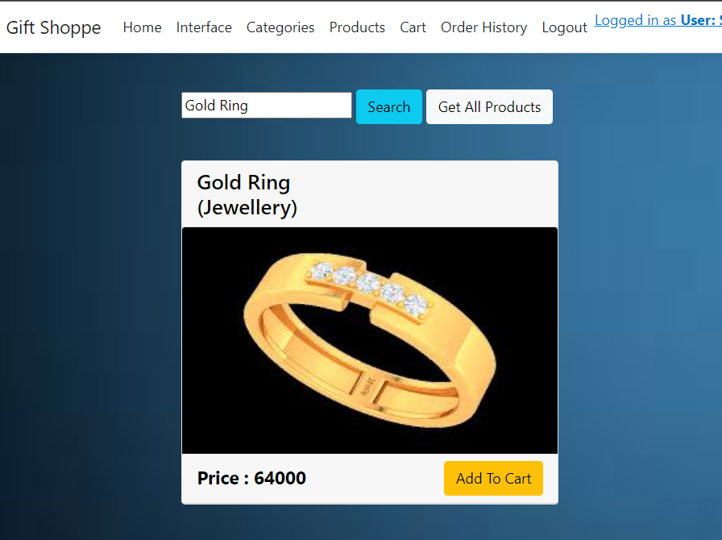
Add to Cart

Slide 49
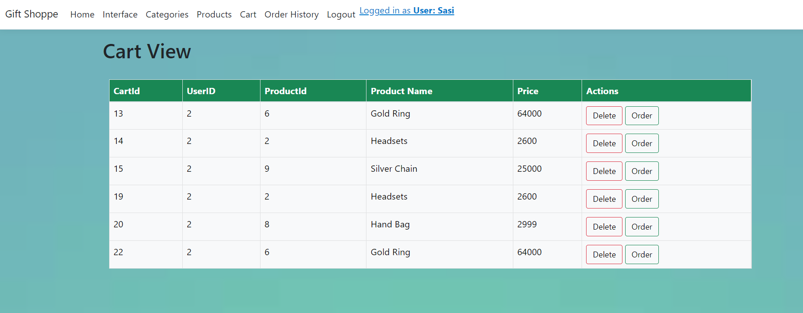
Cart View
The user can place or delete an order.

Slide 50
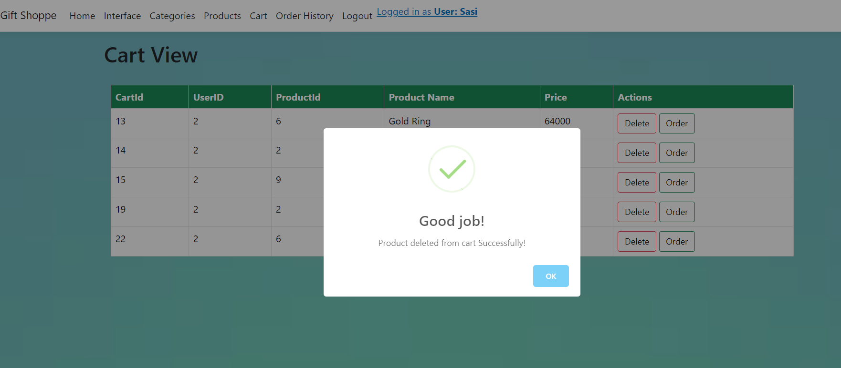
Removing a Product from Cart

Slide 51
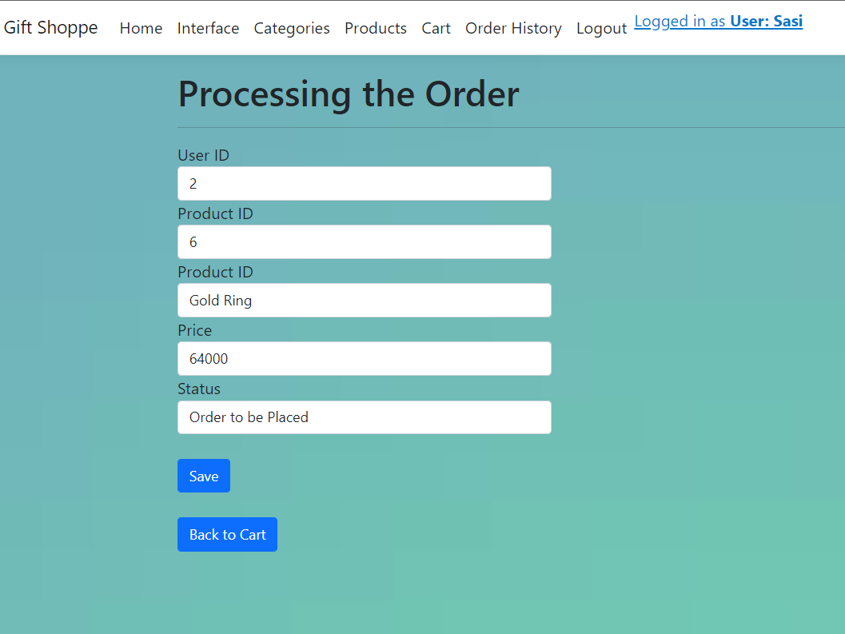
Ordering a Product from the Cart

Slide 52
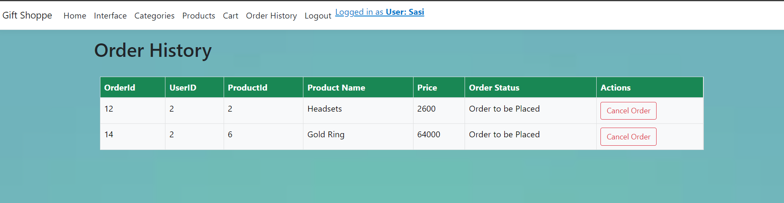
Order’s Page
After placing the order, the user can cancel the order.

Slide 53
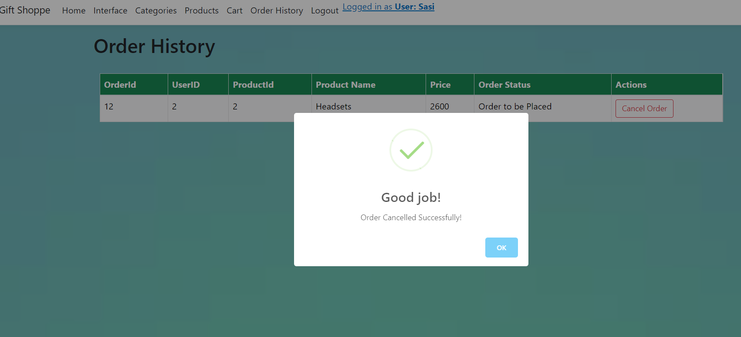
Cancelling an Order

Slide 54
LogOut Page

Slide 55
Conclusion:
Things added from the Requirements:
Registration Page, Login Page, Password Reset, Help.
Admin: Login, Products Interface, CRED operations on Users & Products & Categories, Manage Orders, Update Order Status.
Users: Login, Products Interface, Explore Categories, Search Products, Add To Cart, Order from Cart, Cancel Order.
Privacy

Slide 56
Thank You
Published URL: https://giftshoppe-wipro.azurewebsites.net/

